Slide 1
Process Synchronization Lesson 5 Monitor, Liveness, & Evaluation
David Liu
Fall 2021, Spring 2022

Slide 2
Monitor For a Purpose
Semaphore and other synchronization tools may be used incorrectly
High-level construct
signal (mutex) …. wait (mutex)
wait (mutex) … wait (mutex)
Omitting of wait (mutex) and/or signal (mutex)

Slide 3
Monitor For a Purpose
High-level construct
An abstract data type: encapsulates data with a set
of functions to operate on that data
A Monitor type is an ADT
A set of programmer-defined operations
Operations are provided mutual exclusion
within the monitor
Variables for the state of a monitor
monitor monitor-name
{
// shared variable declarations
function P1 (…) { …. }
function P2 (…) { …. }
function Pn (…) {……}
initialization code (…) { … }
}

Slide 4
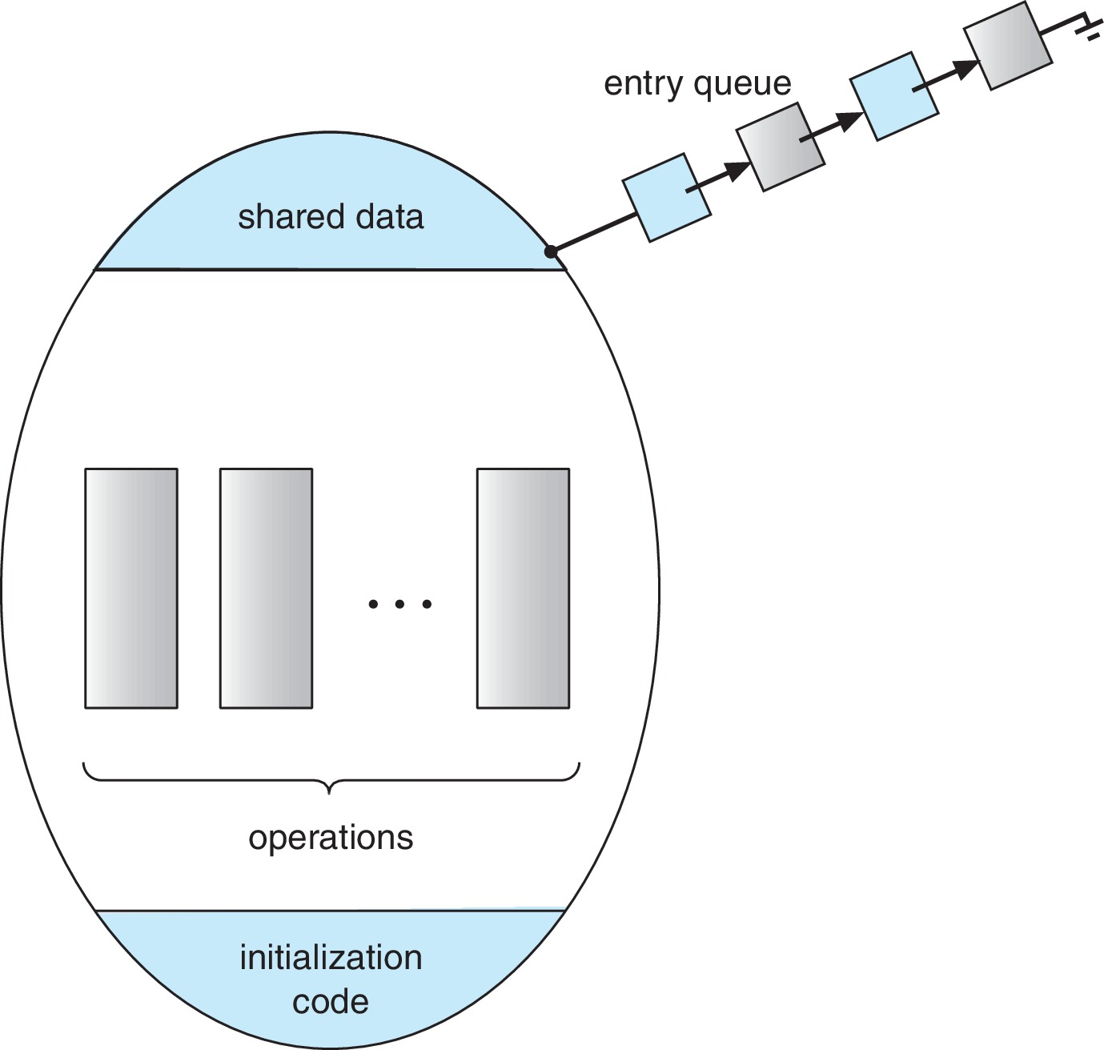
Monitor Schematic
Only one process at a time is active

Slide 5
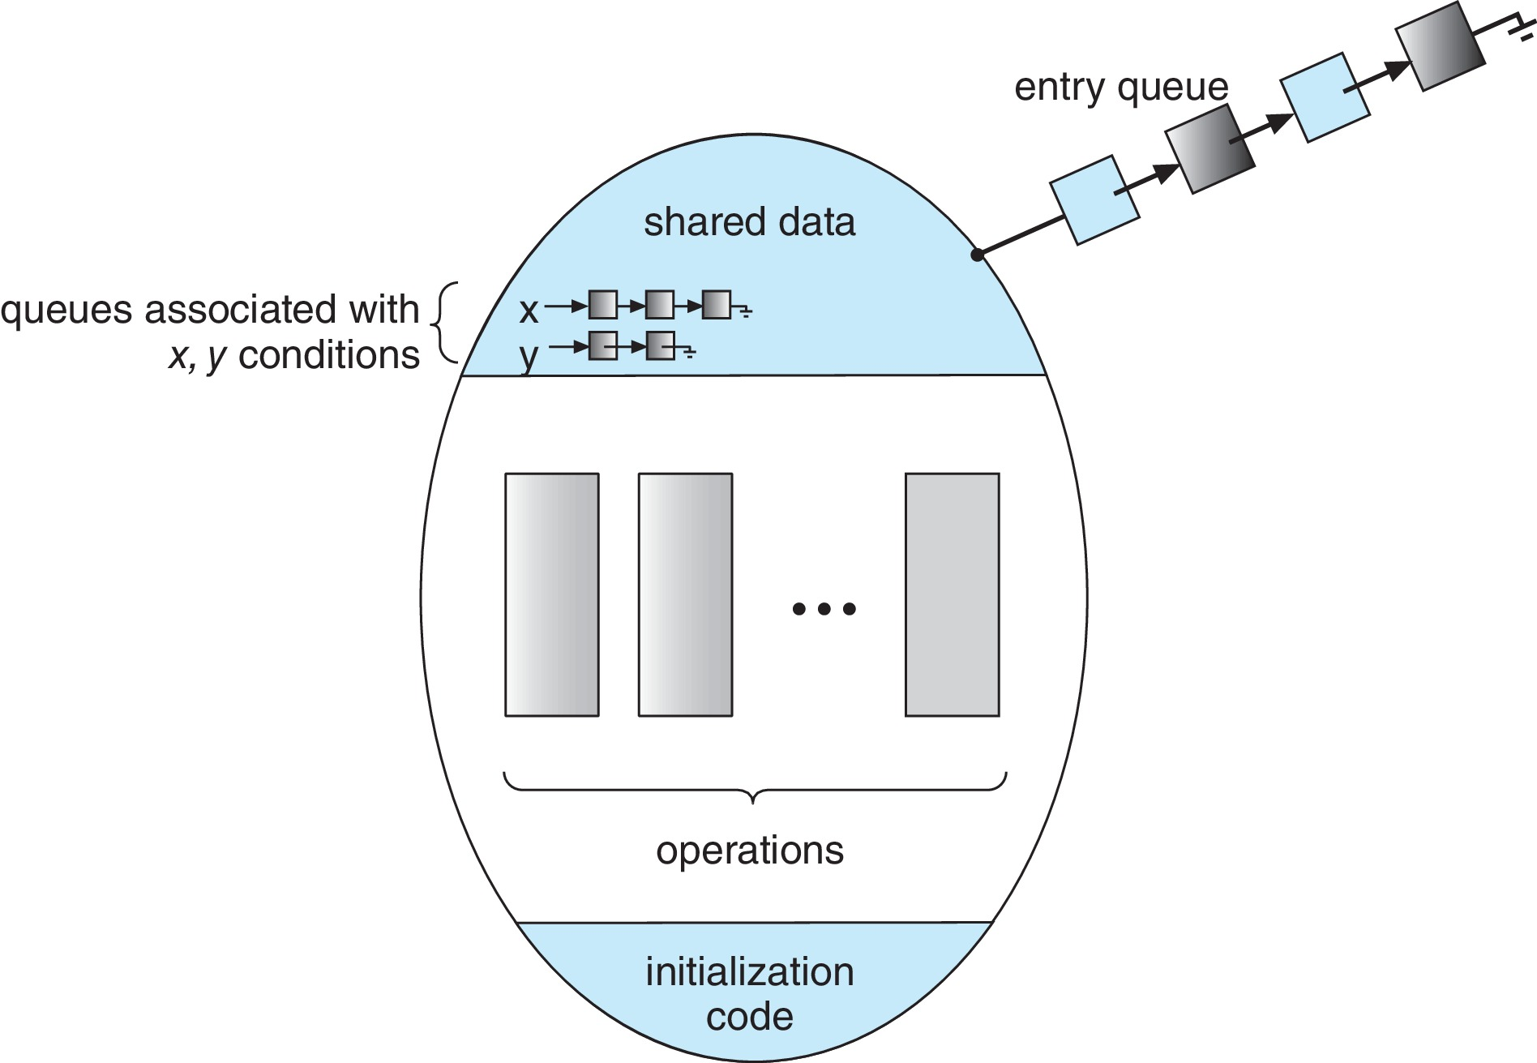
Monitor Schematic
condition x, y;
Two operations are allowed on a condition variable:
x.wait() – a process that invokes the operation is suspended
until x.signal()
x.signal() – resumes one of processes (if any) that invoked
x.wait()
If no x.wait() on the variable, then it has no effect
on the variable

Slide 6
Who Should Stay, P or Q?
If process P invokes x.signal(), and process Q is suspended in x.wait(), what should happen next?
Both Q and P cannot execute in parallel. If Q is resumed, then P must wait
Options include
Signal and wait – P waits until Q either leaves the monitor or it waits for another condition
Signal and continue – Q waits until P either leaves the monitor or it waits for another condition
Compromise - P executing signal immediately leaves the monitor, Q is resumed (Concurrent Pascal )

Slide 7
Monitor Implementation Using Semaphores
Variables
semaphore mutex; // (initially = 1)
semaphore next; // (initially = 0)
int next_count = 0;// # of processes
// suspended in next
Each function F will be replaced by
wait(mutex);
…
body of F;
…
if (next_count > 0)
signal(next)
else
signal(mutex);
Mutual exclusion within a monitor is ensured
Binary
Signal and wait

Slide 8
Monitor Implementation – Condition Variables
For each condition variable x, we have:
semaphore x_sem; // (initially = 0)
int x_count = 0;
x.signal()
x.wait()
if (x_count > 0) {
next_count++;
signal(x_sem);
wait(next);
next_count--;
}
x_count++;
if (next_count > 0)
signal(next);
else
signal(mutex);
wait(x_sem);
x_count--;

Slide 9
Process Resume from x.signal()
FCFS
Priority based
x.wait(priority_num)

Slide 10
Monitor Example: Single Resource Allocator
monitor ResourceAllocator
{
boolean busy;
condition x;
void acquire(int time) {
if (busy)
x.wait(time);
busy = true;
}
void release() {
busy = FALSE;
x.signal();
}
initialization code() {
busy = false;
}
}
maximum time a process plans to use the resource

Slide 11
Liveness
Processes may have to wait indefinitely while trying to acquire a synchronization tool such as a mutex lock or semaphore.
Waiting indefinitely violates the progress and bounded-waiting criteria discussed at the beginning of this chapter.
Liveness refers to a set of properties that a system must satisfy to ensure processes make progress.
Freedom from deadlock
Freedom from starvation
Better bounded bypass
Indefinite waiting is an example of a liveness failure.

Slide 12
Liveness
Deadlock – two or more processes are waiting indefinitely for an event that can be caused by only one of the waiting processes
Let S and Q be two semaphores initialized to 1
P₀ P₁
P0
P1 wait(S); wait(Q);
wait(Q); wait(S);
... ...
signal(S); signal(Q);
signal(Q); signal(S);
Consider if P₀ executes wait(S) and P₁ wait(Q). When P₀ executes wait(Q), it must wait until P₁ executes signal(Q)
However, P₁ is waiting until P₀ execute signal(S).
Since these signal() operations will never be executed, P₀ and P₁ are deadlocked.

Slide 13
Liveness
Other forms off not liveness:
Starvation – indefinite blocking
A process may never be removed from the semaphore queue in which it is suspended
Priority Inversion – Scheduling problem when lower-priority process holds a lock needed by higher-priority process
Solved via priority-inheritance protocol

Slide 14
Priority Inheritance Protocol
Consider the scenario with three processes P1, P2, and P3. P1 has the highest priority, P2 the next highest, and P3 the lowest. Assume a resource P3 is assigned a resource R that P1 wants. Thus, P1 must wait for P3 to finish using the resource. However, P2 becomes runnable and preempts P3. What has happened is that P2 - a process with a lower priority than P1 - has indirectly prevented P1 from gaining access to the resource.
To prevent this from occurring, a priority inheritance protocol is used. This simply allows the priority of the highest thread waiting to access a shared resource to be assigned to the thread currently using the resource. Thus, the current owner of the resource is assigned the priority of the highest priority thread wishing to acquire the resource. (P3 inherits P1’s priority)

Slide 15
Which Synchronization Tools to use
Lock free: optimistic, using compare_and_swap,
optimistically first update a variable and then use collision detection
to see if another thread is updating the variable concurrently
for uncontended or moderate contention
Mutex lock: pessimistic, for high contention
Atomic integers are much lighter weight than tradition locks
Spinlocks on multiprocessor systems
Mutex is less overhead than binary semaphore
Monitors and condition variables have significant overhead

